Slide 1
IOT Analytics Kick Off Meeting
Michelle Giniewicz September 13, 2022

Slide 2
Agenda
Background
Objectives / Goals
Data Management
Descriptions and Location of Related Data
Known Issues with Data & How to Address Them
Descriptive Statistics
Recommendations

Slide 3
Background
A large regional residential developer is interested in adopting the use of electrical sub-metering devices for power management in a large ‘Smart Home’ apartment housing development
Submetering – measuring electric use of individual apartments via a building-owned meter installed in each apartment

Slide 4
Objectives / goals
The main objectives of this project are:
Finding evidence to support that sub-meters provide owners with ‘useful’ power usage analytics
Performing a deep dive of sub-metering data to produce visualizations that support a positive narrative around sub-metering
Predicting future energy consumption to support that sub-metering can help reduce energy consumption and result in monetary savings

Slide 5
Data Management
Data will be securely stored
Data will be accessed by IOT employees on a need-to-know basis
None of the original data will be modified – any analysis will be performed on a secure copy of the data
After the project is complete, the data will be securely disposed.

Slide 6
Descriptions and Location of Related Data
Initial analysis of data set with 47 months of energy data from submetering:
Data ranges from December 16, 2006 – November 16, 2010
Data is gathered from a house located near Paris, France
Dataset contains almost 2.1 million rows of data
Dataset contains multiple attributes including: ID, Date, Time, Global Active Power, Global Reactive Power, Global Intensity, Voltage, Submetering 1, Submetering 2, and Submetering 3
Submetering 1 = power usage from the Kitchen (dishwasher, oven, microwave)
Submetering 2 = power usage from the Laundry Room (washer, dryer, refrigerator, and light)
Submetering 3 = power usage from the water heater and air conditioner

Slide 7
Known Issues with Data & How to Address Them
Issue
Resolution
Data from the 2006 and 2010 tables are not full years
Dataset contains missing values in 1.25% of the rows
There appears to be some outliers in the data, especially for Submetering 1 and Submetering 2
We can analyze the complete data from the years 2007-2009
We can remove records with missing values and/or try to recover the missing data
We will investigate potentially removing the outliers, if they are negatively impacting the analysis

Slide 8
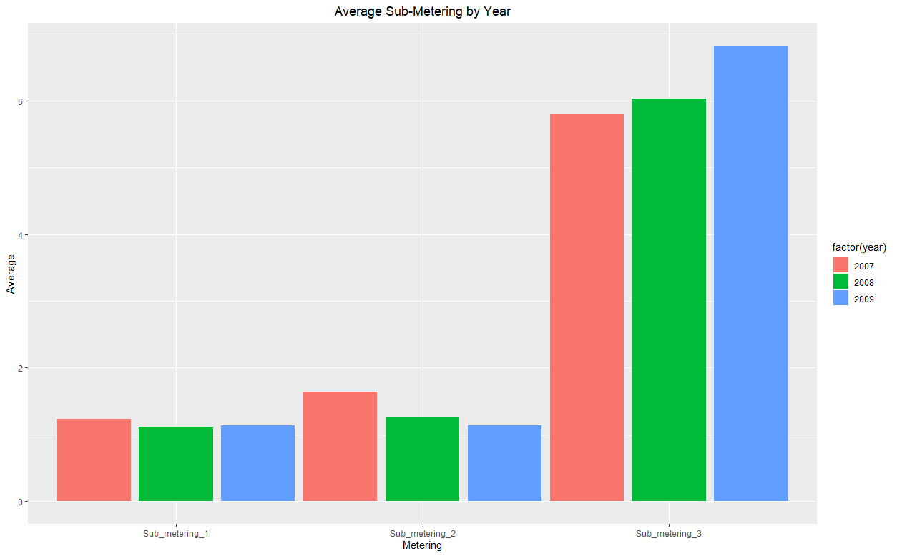
Descriptive Statistics
Below are the findings from our initial analysis of the data from 2007-2009, focusing only on: Date, Time, Submetering 1, Submetering 2, and Submetering 3
Submetering 3 has a much higher average, even though it has the lowest max value. Based on this, there are likely outliers in Submetering 1 & Submetering 2.
There does not initially appear to be significant differences in the data by year.
Attribute | Value Range (watt-hour) | Average Value (watt-hour)
Submetering 1 | 0 – 82 | 1.16
Submetering 2 | 0 – 78 | 1.34
Submetering 3 | 0 – 31 | 6.22

Slide 9
Recommendations
If possible, gather a more complete dataset that has <0.5% missing data
Split out the air conditioner and water heater into their own submetering attributes
Since air conditioners make up 45-50% of a home’s overall energy usage, it would be helpful to see how much this appliance uses on its own
Include refrigerator in Submetering 1, with the other kitchen appliances
Add outside temperature to the dataset
This would help see if there is a correlation between the current temperature and power usage (for example, the a/c likely uses more power when it is very hot outside)
This could also help with predicting how much power a home will use in the future

Slide 10
Thank you for partnering with iot analytics!
We look forward to helping you meet your goal of offering highly efficient Smart Homes that provide owners with power usage analytics!

